Slide 1
The Rise of The Scanners:
From Polars to Pixels:
What future for the polarising light microscope?

Slide 2
Introduction and Scope of Talk
For nearly 200 years the polarising microscope has been more than just the tool of choice for petrography, it has been an essential item of equipment for analysis of thin sections and polished blocks in fields as diverse as sedimentary petrography, cement clinker analysis, coal macerals, concrete, in built structures, archaeometry, melissopalynology and others.
"In daily concrete construction and engineering routine, 'microscopy applied to building materials’ is largely synonymous with ‘aggregate assessment’."

Slide 3
Introduction and Scope of Talk
Recently, digital microscopes and digital scanners have effectively used the optics from a polarising microscope to intercept the image, previously seen directly by the petrographer, and convert it into a digital representation which can be converted back into an image on a screen or monitor.
What new opportunities does this technology offer and do digital slide scanners herald the end of the road for light microscopes?

Slide 4
The Polarising Microscope
Since the pioneering work in Edinburgh 200 years ago of Nicol (1829) on light polarisation, and his development of the technique of making thin sections from rock, petrographers have looked at rocks down the eyepiece of a microscope. The requirement for polarisation means that petrography is a niche market, for both microscope manufacturers and accessories. For instance, whereas there are dozens of fully automated slide movement devices available for the medical microscopist, there is only one for petrography (www.petrog.com see e.g. Quinn 2013, Poole and Sims 2016).
Notes:
The Pelcon device is semi-automated, a golf-ball typewriter to the fully automated device's word processor

Slide 5
The Polarising Microscope: External Developments
Image capture: Cameras
  Analogue cameras with film
  Analogue cameras with a frame-grabber card
  Digital cameras:
    charge-coupled device (CCD)
    complementary metal oxide sensor (CMOS)
    scientific CMOS (sCMOS) sensors.
Image stitching

Slide 6
Technical Issues and Limitations
Image Quality:
  Dynamic Range
  Oversaturation
  White balance
  Shading
  Lens distortion
Image Registration:
  Sample stage drift

Slide 7
Dynamic Range
Quantitative image analysis requires images to be recorded over a large dynamic range (Beckers et al., 1994). This is a big challenge for photography of rock thin sections, which can contain collections of minerals with very different optical properties, ranging from colourless perfectly transparent, vividly coloured and variably transparent and opaque but variably reflective. Obtaining digital images of thin sections that truthfully reflect these properties is difficult, particularly when imaging entire 50x25 mm slides, where minerals may be very heterogeneously distributed.

Slide 8
Oversaturation
Oversaturation is a common artefact in geological slide scanning that could quite readily be avoided with better training.
Oversaturated areas tend to concentrate in whiter minerals or around grain boundaries where there are significant grain relief differences projecting towards neighbouring grains of similar intensities (e.g., chalcopyrite around pyrite).

Slide 9
White balance
Human perception automatically adjusts colours for different lighting situations by referencing neutral colour objects. In digital cameras this work needs to be done with a white balance correction with respect to a selected illuminated object of a neutral-coloured scene.

Slide 10
Shading
Shading (i.e., inhomogeneity, non-uniformity) is a position-dependent additive term to the pixel intensity resulting in clearly visible brightness differences or jumps (i.e., vignetting, visible seams) in the overlapping areas of adjacent tiles in a mosaic. The shading variations, which are often spurious, manifest as large-area intensity gradients that are not present in the original scene.
In optical microscopy, these effects are related to some or all of:
  non-ideal illumination conditions along the optical path in the microscope, e.g.
    uniform light source, Köhler illumination;
    presence of dust in the optical path;
    non-uniform filters);
  sample conditions (e.g., mounting, thickness, topography)
  external factors (nearby environmental factors (e.g., stage, chamber), electronic components).
In typical petrographic microscope photography, shading is dominantly caused by uneven illumination, rather than by sample preparation or due to effects in the light path from the sample to the camera.

Slide 11
Lens distortion
In modern-day optical microscopy, the optics yield small perspective distortion and/or imaging artefacts.
In microscopy of concrete it is recommended to create thin sections to 15 µm, rather than the 30-40 µm common elsewhere, to minimise oblique grain boundary image artefacts, (e.g., Broekmans et al. (2022)).
Lens distortions occur because of the spherical geometry of lens surfaces, which currently is the only practical approach in lens design.
Petrographic microscopes are built to last and high-end versions are expensive, so petrographers will be working with instruments of various vintages. Scanners are even more expensive so any lens distortion in current technology will continue to be an issue.

Slide 12
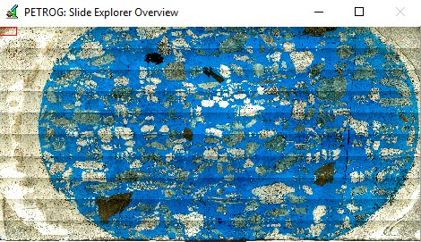
Image Capture Issues: Example

Slide 13
Sample stage drift
"My initial assessment of the quality of stitched microscope mosaics obtained on the Leica DM6000 petrographic microscope (CARF, QUT) with a translational stage identified tile misplacement as a significant source of error (dxi, dyi). When samples are securely fixed to the stage, misplacement occurs due to odometric error from cumulative drifts of the stepper motor stage and compounded mechanical hysteresis. Rotational misplacement is not expected as the stage movement is strictly orthogonal, unless the sample is not securely fixed to the stage or holder, however, the camera might be slightly rotated (α degrees) with respect to the programmed scanning areas (image tiles), introducing a small rotation that can be a conspicuous pixel offset at the tile corners."
Acevedo Zamora, M. [2024].
Notes:
As we make and sell stepping stages, it is best to reference an independent assessment

Slide 14
PETROGRAPHIC MICROSCOPY OF GEOLOGIC TEXTURAL PATTERNS AND ELEMENT-MINERAL ASSOCIATIONS WITH NOVEL IMAGE ANALYSIS METHODS
Marco Andres Acevedo Zamora
Ph.D. thesis, Faculty of Science Queensland University of Technology 2024

Slide 15
Semi-automatic Evaluation of Data
Users of digital photography from petrographic microscopes and scanners need to be aware that these factors all potentially impact on the ability to semi-automatically evaluate data contained in stitched multi-modal mosaics.
For capturing images from a conventional microscope for subsequent stitching , adequate Köhler illumination, large area scanning and stepwise auto-focusing options need to be set up before triggering the acquisition, especially at higher numerical apertures (higher magnification) that have shallow depths of field.

Slide 16
Semi-automatic Evaluation of Data
"In petrography, we should avoid working with all-in-focus images, so called ‘extended depth of focus’, that do not represent the surface of the sample and were originally developed for material science metrology (e.g., microchips). With image segmentation in mind, it is advisable to work with medium and high numerical apertures, various modalities, polarising pair orientations (‘multi-pol’ image stacks), and aiming to have premium polish to reduce the ambiguities of crystal orientation (cross-polarised light), blurring, and low-angle grain contacts."
Acevedo Zamora, M. [2024].

Slide 17
Image Registration
Image stitching (i.e. mosaicing, compositing) of grids of adjacent images (FoV, captures, tiles) is needed to create whole-side mosaic (montages) – whether in satellite imagery, panorama photography, high-resolution optical microscope imagery, or high magnification electron microscope imagery.
Image registration methods are generally either intensity-based (pixel-based, area-based, block-matching, histogram-based, direct, frequency-based, correlation methods) or feature-based (landmark-point-based, interest point-based).

Slide 18
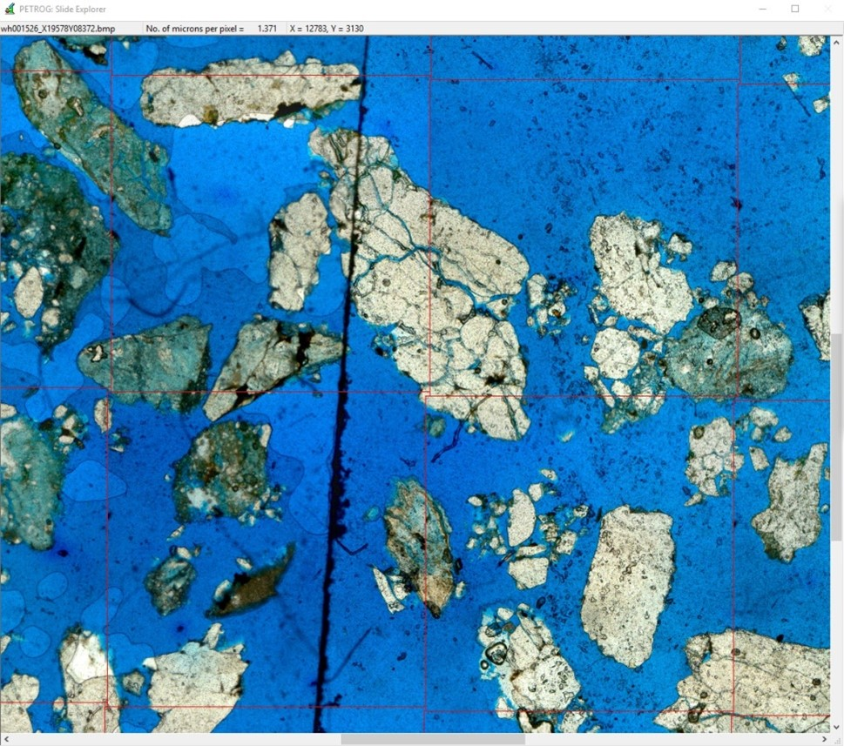
Image Registration
Pairwise registration of tiles produces artefacts and false-positive matches, because each pair interacts with every other pair:

Slide 19
Image Registration
Different approaches are available, e.g. Scale Invariant Feature Transform (SIFT)
The research group at the National Institute of Standards & Technology (NIST) (Blattner et al., 2014; Joe Chalfoun et al., 2017) pioneered very fast image stitching in an attempt to enable time-lapse observational studies in different image modalities of entire cell cultures under cultivation. For this, they created the MIST plugin (Fiji) available in ImageJ.

Slide 20
Digital Microscopes (Wikipedia)
A digital microscope is a variation of a traditional optical microscope that uses optics and a digital camera to output an image to a monitor, sometimes by means of software running on a computer.
An early digital microscope was made by a company in Tokyo, Japan in 1986, which is now known as Hirox Co. LTD.
Stereo and digital microscopes
A primary difference between a stereo microscope and a digital microscope is the magnification. With a stereo microscope, the magnification is determined by multiplying the eyepiece magnification times the objective magnification. Since the digital microscope does not have an eyepiece, the magnification cannot be found using this method. Instead the magnification for a digital microscope was originally determined by how many times larger the sample was reproduced on a 15” monitor. While monitor sizes have changed, the physical size of the camera chip used has not. As a result, magnification numbers and field of view are still the same as that original definition, regardless of the size of the monitor used. The average difference in magnification between an optical microscope and a digital microscope is about 40%. Thus the magnification number of a stereomicroscope is usually 40% less than the magnification number of a digital microscope.
Since the digital microscope has the image projected directly on to the CCD camera, it is possible to have higher quality recorded images than with a stereo microscope. With the stereo microscope, the lenses are made for the optics of the eye. Attaching a CCD camera to a stereo microscope will result in an image that has compromises made for the eyepiece. Although the monitor image and recorded image may be of higher quality with the digital microscope, the application of the microscope may dictate which microscope is preferred.

Slide 21
Scanners
‘Slide scanners’ are rapid optical microscopes equipped with automated and accurate x-y travel stages with virtual z-motion that cannot be rotated. In biomedical microscopic imaging, they are widely deployed to generate whole-slide images (WSI) of tissue samples in various modes of illumination. The availability of WSI has motivated the development of instrument-agnostic advanced image analysis software, helping drug development, pathology, and many other areas of research. Slide scanners are now being modified to enable polarised petrographic microscopy by simulating stage rotation with the acquisition of multiple rotation angles of the polariser–analyser pair for observing randomly oriented anisotropic materials.
The relegation of the polarised light microscope to a qualitative tool has not (yet) been reversed by the advent of data management tools (Wallace et al., 2015), high-quality digital microscope cameras, scanning software, and automated stages that allow stitching of image tiles or frames into mosaics of an entire thin section (i.e., slide scanning).
Scanners have similarly been slower to appear for polarisation applications, although there are now at least three available on the market (Zeiss, Olympus and Glissando). The question is, after nearly 200 years of being the tool of choice for petrographers, has the microscope now been superseded by the scanner? Have scanners now reached the level of sophistication that makes microscopes obsolete, or at best an arcane specialism within this already niche field? Or do scanners complement traditional light microscopy? Ignoring the different levels of investment required, which for now at least put scanners beyond the reach of many, we will look at the operational capabilities of each technology and at how they can work together.

Slide 22
Stage Rotation
One key reason that petrological polarised light microscopy has not embraced digital WSI is that the most diagnostic properties of minerals derive from optical anisotropy (orthotropic materials), whose effects are exposed in polarised light (Raith et al., 2012). Coupled with the fact that in most rocks, crystals are not unidirectionally aligned, anisotropy causes some crystals of the same mineral to assume different appearances. Optical mineralogists exploit the diagnostic orientation dependence of anisotropy by visual inspection with stage rotation and insertion of an analyser and retardation plates into the light path.
Some slide scanning manufacturers have begun offering instruments with orthogonally moving x-y-z stages but with rotatable polarisers and polariser–analyser pairs (Matthew, 2021). Aided by the very rapid acquisition, multi-angle (or multi-pol) WSI increases the demand for stacking several scans and generating a virtual approximation to stage rotation.

Slide 23
Scanners
Zeiss - The software of the AxioSCAN 7 Geo of Zeiss is well tailored to petrography using wave plates (circular polarisation, ‘c-pol’). The software ecosystem and broadcasting applications allow digital stage rotation (ZEN software), image segmentation, particle reporting, and cross-referencing microscopy against mass spectrometry imaging.
Olympus - VS200 single tray (ST), a first-generation integrated optical microscope designed for research (not diagnostic) purposes. Its original setup can perform brightfield (BF), fluorescence (FL), and phase-contrast (PH) microscopy and their combinations. FL uses specialised techniques, such as confocal microscopy, to study cells in z-stacks, dark-field (DF) for following stem cell colonies within referential overviews, and differential interference contrast (DIC) to better understand optical path-difference ‘relief’, all of which require special filters. In collaboration with the manufacturer Evident Scientific (formerly Olympus), we have repurposed the VS200 polarised transmitted (POL) and brightfield reflected light (RL) modalities to perform petrographic plane-polarised (PPL) and cross-polarised (XPL) observation in multi-angle polariser orientations.
Objective Imaging – Glissando POL, Brightfield and Polarized Light Scanner. Currently only available in 4X, 10X, 20X and 40X objective configurations.

Slide 24
Glissando POL
Capacity 2 standard 75x25 mm slides or 1 double-width 75x50 mm mega slides. Glass plate specimen holder included to accommodate different specimen sizes up to 75x50 mm.
Imaging modalities Brightfield and polarised light.
Imaging mode switching Manual switching, dual lever design.
Scanning engine Turboscan™ tile scanning with predictive focus map
Objective lens Single plan fluorite objective lens for polarised light applications; choose from 4X, 10X, 20X, or 40X magnification
Scan image resolution 4X: 1.23 µm/pixel; 10X: 0.49 µm/pixel; 20X: 0.25 µm/pixel; 40X: 0.12 µm/pixel.
Z-stack scanning Yes, with 3D and extended focus modes
Scan output formats SWS, SVS, SZI, TIFF/BigTIFF with user-configurable compression
Control computer Internal mini-PC with Ethernet connection and touchscreen monitor
On-board storage 500 GB solid state drive

Slide 25
Glissando POL
The Glissando POL offers high-resolution scanning in both brightfield and polarised light. Easily switch between brightfield and polarised modes manually using a simple two-lever design, with the Glissando POL software offering user-configurable illumination and camera settings to ensure exceptional image quality in each configuration. The dual-purpose Glissando POL scanner produces high-fidelity brightfield and polarised whole specimen images in a variety formats, ensuring compatibility with numerous image viewing, sharing, and analysis packages.

Slide 26
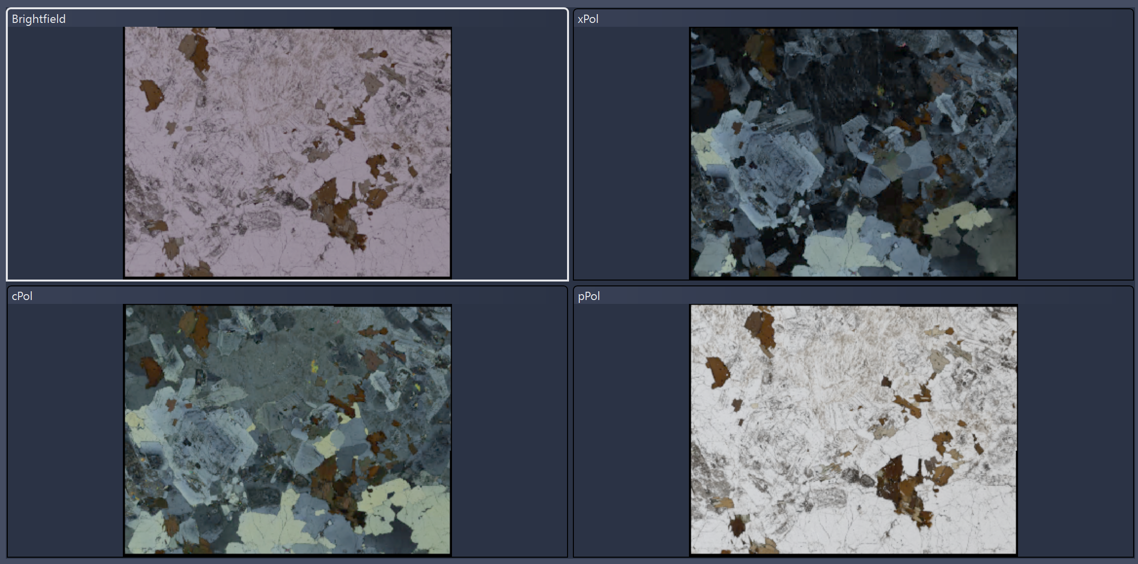
Zeiss CZI (Carl Zeiss Image file)
Can contain multiple channels, each showing a view of the sample under specific lighting conditions e.g. Plain-light (pPol), Cross-polarised light (xPol), Circular polarisation (cPol), Brightfield.

Slide 27
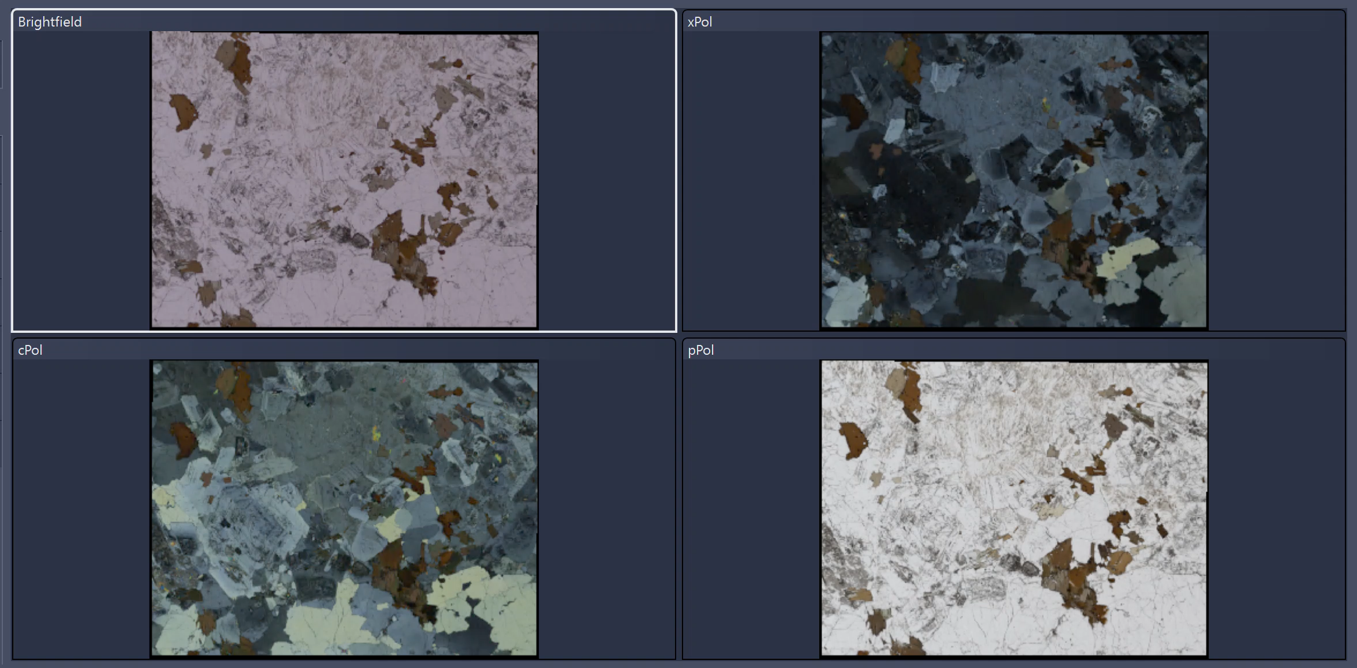
Zeiss CZI (Carl Zeiss Image file)
The polarisation angle can be varied, so here you see the XPL view change with the rotation angle.
This example has 16 channels (Brightfield, cPol, pPol, + 13 xPol at different angles). File size is 900Mb.

Slide 28
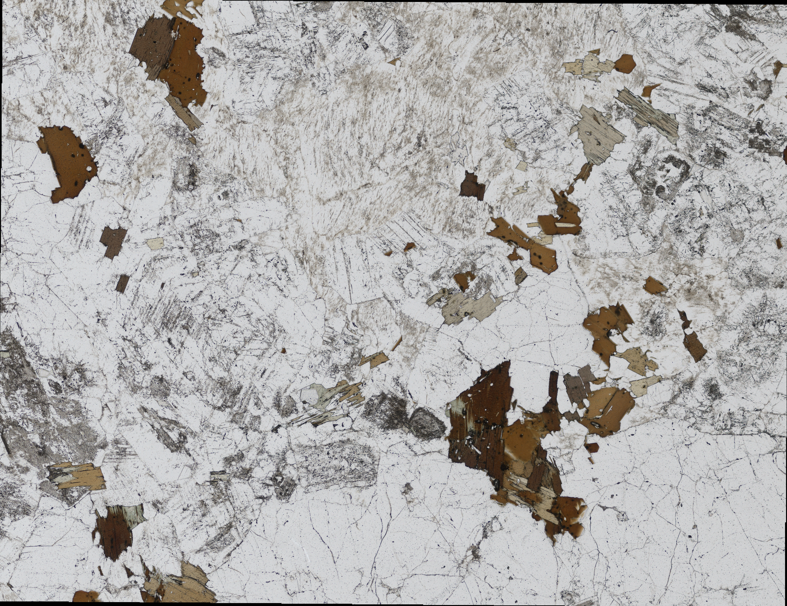
Zeiss CZI (Carl Zeiss Image file)
Any channel can be exported as an individual image to a number of standard formats e.g. TIFF.
This image (PPL view) is 20684 x 15920 pixels in dimension, and has file size 780 Mb.

Slide 29
The Polarising Microscope: What it does
Point counting
Image capture: take a picture at each point counted, these should cover the side, so can be stitched to make a whole-slide mosaic. This has been standard for at least 10 years. 2 options
  Tiles (c.f. Google maps)
  Single large image (c.f. Gigapan). JP2 would have facilitated this.

Slide 30
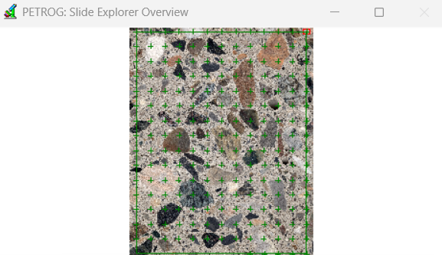
Example of Data entry from Whole Slide Images of Concrete Samples
Set Area of Interest
Set Data Entry Methodology
Start collecting data
The completed Area of Interest will be displayed, optionally with the locations of points to be visited
Notes:
PETROG software combined with scanner image: example

Slide 31
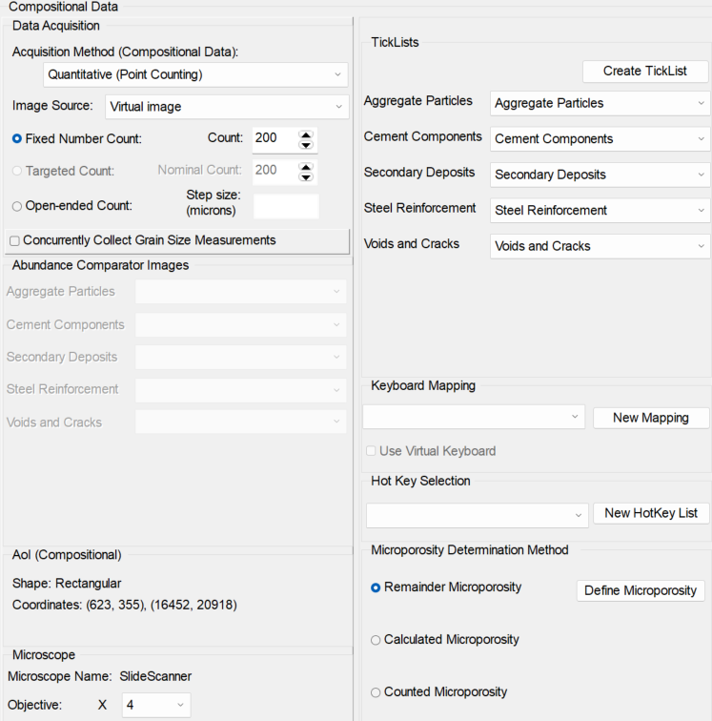
Example of Data entry from Whole Slide Images of Concrete Samples
Set Area of Interest
Set Data Entry Methodology
Start collecting data
Sample | Data Entry Methodology
Remember to specify ‘Virtual image’ as the image source!

Slide 32
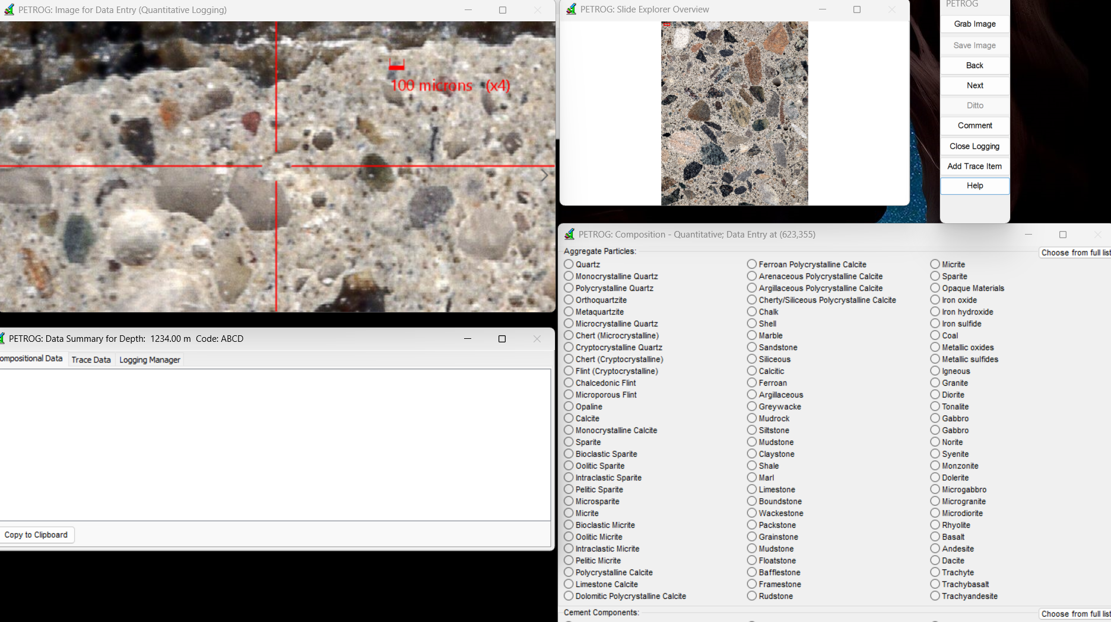
Example of Data entry from Whole Slide Images of Concrete Samples
Set Area of Interest
Set Data Entry Methodology
Start collecting data
Data Entry | Composition - Quantitative

Slide 33
The Polarising Scanner: What it does
Takes lots of images – how many, how large? What can be done with them?
A 15 channel scan of a thin section could be about 4GB

Slide 34
The Polarising Scanner: What it adds
The availability of a whole slide image greatly advances the possibilities afforded by AI.
This is true whether the whole slide image is generated automatically by a scanner or as a mosaic created semi-automatically from images captured by a microscope camera and a stepping stage, but the scanner makes it more readily available.
Notes:
'Adds' is perhaps stretching the point, because we could already do this, but scanners do make it simpler.

Slide 35
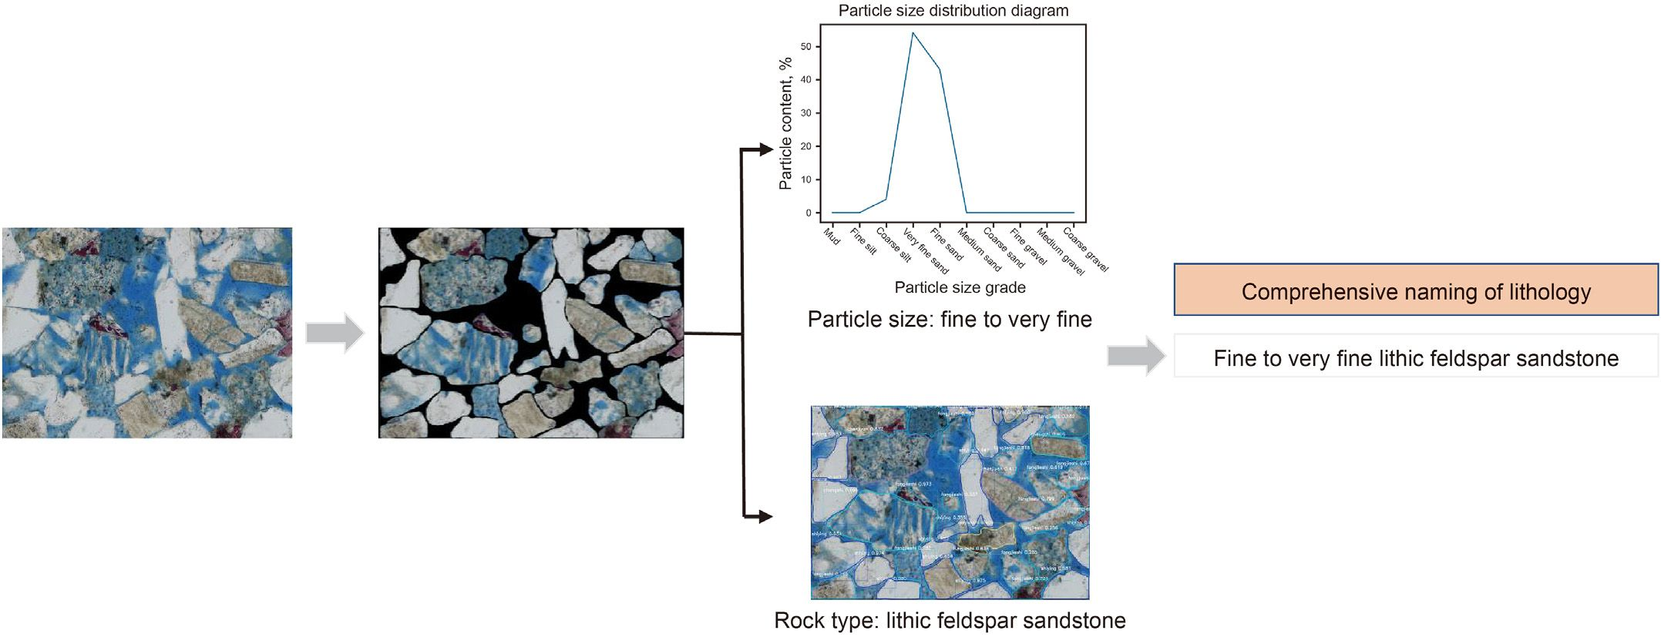
Rock thin-section analysis and identification based on artificial intelligent technique
He Liu et al, PetroChina Research Institute of Petroleum Exploration & Development
Notes:
Using petroleum examples because this is where most of the R&D is taking place.

Slide 36
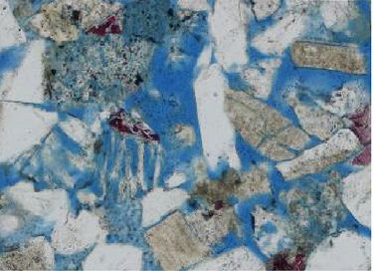
Whole Slide versus Single Field of View
In a single FoV, many grains will fall partly outside the image.
In the example from He Liu et al, about 40% of the grains lie across the image boundary.
Probabilistically, these will disproportionately be the largest grains. The predicted size distribution will therefore be biased towards smaller grains.

Slide 37
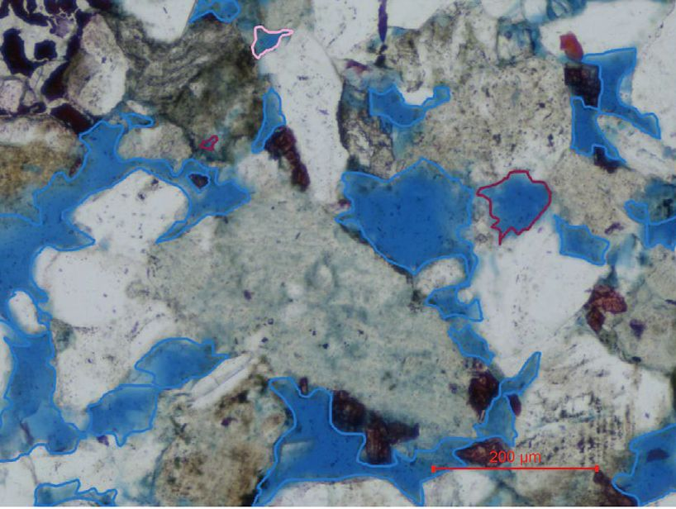
Whole Slide versus Single Field of View
This consideration becomes more important when analysing the pore system: pores may be connected across many tiles.
But it is not currently feasible to analyse the entire image as one because of size limitations.

Slide 38
The Polarising Scanner: Current Limitations
Most analysis is undertaken using Microsoft operating systems.
The Microsoft bitmap is currently limited to file size 8192 x 8192
A typical whole slide scan image, at 10X, may be 30,000 x 40,000 pixels, each pixel containing colour information, so occupying 32 bits of memory.
Zeiss has published its czi format, making it open but not a standard. Olympus and Glissando are unlikely to use it (especially as the 'cs' stands for Carl Zeiss).
The JP2 (JPEG 2000) standard might have fulfilled this requirement but in the 25 years since its release it has not been widely adopted outside the motion picture industry and hence support is sparse.

Slide 39
Scanner versus Semi-automatic Mosaic: 1
Why "The Polarising Scanner: Current Limitations"?
Collecting images with a stepping stage and then stitching provides a natural or intrinsic tiling. Object-Based Image Analysis (OBIA) can be performed tile-wise and the resultant object map combined, to eliminate (internal) edge effects.
It is of course possible to tile a scanned image (which was captured as a set of tiles - and next-generation scanner software may provide this as an optional output) but for now this is a step provided by software required for semi-automatic mosaics.

Slide 40
Scanner versus Semi-automatic Mosaic: 2
How does an AI engine categorise components?

Slide 41
Scanner versus Semi-automatic Mosaic: 2
How does an AI engine categorise components?
It takes more than one example:
He Liu et al

Slide 42
Even this crude categorisation (He Liu et al) would have required a large training set:

Slide 43
How might the training set have been generated?
Notes:
Presumably by point counting or some other human identification process

Slide 44
The Polarising Scanner, Current Limitations:
Sharing Images for Analysis
Scanners create very large data sets, in part because they do not know what the end-user will require so they try to collect everything: PPL, XPL at many angles. If the scanner provides all that a petrographer requires, then the system is closed and the size of the generated data set is immaterial. If, however, there are requirements for more detailed analysis or integration with other data, then sharing is required.

Slide 45
The Polarising Scanner, Current Limitations:
Sharing Images Captured by Different Means
There are “significant technical barriers for registering imagery from different instruments and performing image analysis from the combined data” [Acevedo Zamora (2024)].
This is a challenge when comparing analyses of rock thin section images captured from a polarising microscope against images of the same sample obtained via scanning electron microscopy (SEM), so is not just a limitation of scanners. However, researchers have developed methods to achieve accurate registration e.g. with light microscope images and SEM images.
Wooldridge et al. (2019) investigate the quantification of clay-coat grain coverage in modern sediments from SEM images, and correlate these results against the sample under plain-polarised light utilizing calibration via a gold marker pen (a mark that can be observed under both SEM and the polarising microscope). It is vital when working with extracted images from a scanning system that a similar type of spatial referencing can be carried out.

Slide 46
Conclusions: 1
When working with whole slide images from scanners we must consider not just the ability to work with the whole slide images themselves, but also to ensure that the same possibilities for comparing results against other sample imaging techniques are available as if we were working with the traditional polarising microscope.

Slide 47
Conclusions / Discussion: 2
Technologies should advance our ability to perform tasks deemed to be useful. The availability of high-resolution scanners with polarising capabilities allows us to re-evaluate the tasks undertaken by petrographers, and in particular those traditionally utilising a polarising microscope.
For example, point counting might not be required if automatic identification of objects of interest (OBIA) is available, but that availability is (currently) predicated on the existence of a vast training set, presumably generated from point counting. The requirement for human intervention may change, to identification of the unusual or the exceptions, but is unlikely to be removed altogether.
Might Standards (e.g. C457) require modification?

Slide 48
References
Acevedo Zamora, M. [2024]. Petrographic microscopy of geologic textural patterns and element-mineral associations with novel image analysis methods. Ph.D. Thesis, Queensland University of Technology.
Chayes, F. [1953]. A test of the precision of thin-section analysis by point counter. American Mineralogist 36, 704-712.
Nicol, W. [1829]. On a method of so far increasing the divergence of the two rays in calcareous-spar, that only one image may be seen at a time. Edinburgh New Philos. J. 6, 83-84.
Poole, A. and Sims, I. [2016]. Concrete Petrography: A Handbook of Investigative Techniques. Taylor and Francis, CRC Press.
Quinn, P.S. [2013]. Ceramic Petrography: The Interpretation of Archaeological Pottery and Related Artefacts in Thin Section. Archaeopress.
Sorby, H.C. [1858]. On the microscopical structure of crystals, indicating the Origin of Minerals and Rocks. Quarterly Journal of the Geological Society 14, 453-500.
Wooldridge et al. [2019]. How to quantify clay-coat grain coverage in modern and ancient sediments. Journal of Sedimentary Research, v. 89, 135–146
He Liu et al [2022]. Rock thin-section analysis and identification based on artificial intelligent technique.
Petroleum Science 19, 1605-1621

